Slide 1
Schools Health Survey 2020 – Year 3 Report
October 2020

Slide 2
Contents
Introduction
(slide 3)
How to read the report
(slide 4)
Headline findings
(slides 5 to 7)
Diet and oral health
(slides 8 to 11)
Physical activity
(slides 12 to 14)
Smoking and bullying
(slides 15 to 17)
Wellbeing and free time
v (slides 18 to 20)
Notes
v (slide 21)
Click on the header in a box to be taken to the relevant section in the report.

Slide 3
Introduction
The Wakefield School Survey 2020 was carried out with Year 3, Year 5, Year 7 and Year 9 pupils in the spring term 2020 between January and March 2020, before the national lockdown due to the pandemic.
The Wakefield Council Public Health team have been using the Health Related Behaviour Questionnaire (HRBQ) every two years since 2009 as a way of collecting robust information about young people’s health and lifestyles.
This survey is an essential source of data for both schools and local authority commissioners alike, providing detailed and robust information about the health behaviours and lifestyle choices of the children living in the Wakefield district.
The content of the survey is widely consulted upon and uses age appropriate questions where necessary.
Pupils from Year 3, Year 5, Year 7 and Year 9 took part in the survey either online or via paper copy.
Enventure Research was commissioned to independently analyse and report on the findings.
In total, 1,954 valid responses were received from Year 3 pupils from 60 schools.
This report details responses from Year 3 pupils.

Slide 4
How to read the report
Some response options have been combined i.e. “Strongly agree” and “Agree” to show “Total Agree”.
Respondents were able to skip questions, so the base size varies between questions.
There are several reasons why responses in charts/tables might not add up to 100%:
Respondents might have been able to give more than one answer
Only most common responses might be shown
Individual percentages are rounded to nearest whole number
Responses of between 0% and 0.5% are shown as 0%.
In the inequality and area analysis tables red and green shading denotes statistical differences according to the z-test at 95% confidence level and highlights the inequality.
Most and least deprived cohorts have been determined using the deprivation levels for the area in which pupils’ schools are located¹.

Slide 5
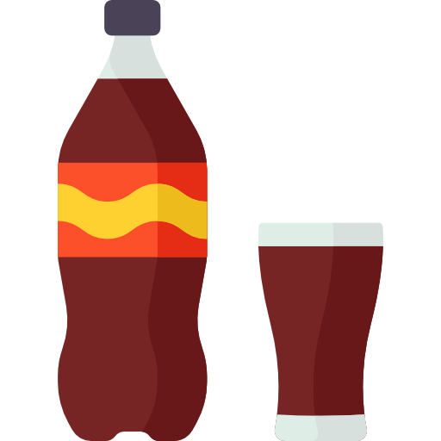
Headline findings
Diet
37% eat vegetables a lot of the time
43% eat fruit a lot of the time
68% drink water a lot of the time
27% drink fizzy drinks a lot of the time
35% eat chocolate a lot of the time
33% eat sweets a lot of the time

Slide 6
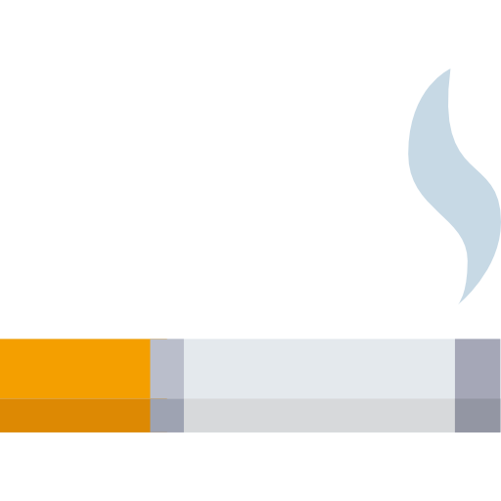
Headline findings
Physical activity, oral health and smoking
78% brush their teeth at least twice a day
13% never play outside at home
41% usually walk to school
25% have someone who smokes inside at home
Whilst 83% do play outside at home at least sometimes
50% usually get to school by car

Slide 7
Headline findings
Bullying, safety, wellbeing and free time
23% feel scared to go to school because they are being picked on
76% felt happy most of the time
37% never go to a club after school
92% enjoy spending time at home with their family
Females were more likely than males to feel scared to go to school because of bullying and less likely to feel happy most of the time.

Slide 8
Diet and oral health
Findings
How often do you eat or drink…?

Slide 9
Diet and oral health
Findings
How many times a day do you normally brush your teeth?
Base: 1,932

Slide 10
Diet and oral health
Inequality analysis
Statistically significantly better than other percentage(s) in group
Statistically significantly worse than other percentage(s) in group
Diet and oral health | All Year 3 | Male | Female | Single parent family | Other families | Young carer | Non-carer | Most deprived | Least deprived
Eat fruit a lot of the time | 43% | 41% | 45% | 37% | 44% | 49% | 42% | 42% | 46%
Eat vegetables a lot of the time | 37% | 36% | 38% | 35% | 38% | 40% | 37% | 36% | 39%
Drink fizzy drinks a lot of the time | 27% | 33% | 21% | 32% | 26% | 28% | 25% | 32% | 25%
Drink water a lot of the time | 68% | 65% | 72% | 67% | 69% | 71% | 68% | 63% | 68%
Eat chocolate a lot of the time | 35% | 37% | 32% | 39% | 33% | 33% | 35% | 39% | 32%
Eat sweets a lot of the time | 33% | 36% | 30% | 28% | 33% | 31% | 34% | 39% | 28%
Brush teeth at least twice a day | 78% | 75% | 81% | 75% | 79% | 79% | 78% | 74% | 77%

Slide 11
Diet and oral health
Area² analysis
Statistically significantly better than other percentage(s) in group
Statistically significantly worse than other percentage(s) in group
Diet and oral health | All Year 3 | Castleford | Normanton & Featherstone | Pontefract & Knottingley | South East | Wakefield Central | Wakefield North West | Wakefield Rural
Eat fruit a lot of the time | 43% | 38% | 38% | 40% | 40% | 46% | 44% | 46%
Eat vegetables a lot of the time | 37% | 34% | 43% | 36% | 41% | 30% | 42% | 36%
Drink fizzy drinks a lot of the time | 27% | 22% | 21% | 36% | 28% | 27% | 25% | 28%
Drink water a lot of the time | 68% | 69% | 68% | 63% | 62% | 71% | 70% | 72%
Eat chocolate a lot of the time | 35% | 34% | 30% | 44% | 34% | 30% | 33% | 37%
Eat sweets a lot of the time | 33% | 35% | 22% | 38% | 34% | 31% | 30% | 35%
Brush teeth at least twice a day | 78% | 76% | 75% | 76% | 79% | 77% | 80% | 80%

Slide 12
Physical activity
Findings
How often do you play outside at home?
How do you usually travel to school?
Base: 1,917
Base: 1,940

Slide 13
Physical activity
Inequality analysis
Physical activity | All Year 3 | Male | Female | Single parent family | Other families | Young carer | Non-carer | Most deprived | Least deprived
Play outside at home every day or some days | 83% | 80% | 86% | 80% | 84% | 82% | 85% | 80% | 88%
Usually walk to school | 41% | 41% | 43% | 43% | 42% | 43% | 41% | 48% | 36%
Usually travel to school by car | 50% | 49% | 51% | 49% | 50% | 48% | 51% | 41% | 56%
Statistically significantly better than other percentage(s) in group
Statistically significantly worse than other percentage(s) in group

Slide 14
Physical activity
Area² analysis
Physical activity | All Year 3 | Castleford | Normanton & Featherstone | Pontefract & Knottingley | South East | Wakefield Central | Wakefield North West | Wakefield Rural
Play outside at home every day or some days | 83% | 80% | 84% | 82% | 85% | 81% | 84% | 83%
Usually walk to school | 41% | 50% | 43% | 46% | 35% | 45% | 37% | 41%
Usually travel to school by car | 50% | 45% | 47% | 45% | 52% | 46% | 57% | 50%
Statistically significantly better than other percentage(s) in group
Statistically significantly worse than other percentage(s) in group

Slide 15
Smoking and bullying
Findings
Do you ever feel scared of going to school because you are being bullied or picked on?
Does anyone smoke inside at home?
Base: 1,920
Base: 1,928

Slide 16
Smoking and bullying
Inequality analysis
Smoking and bullying | All Year 3 | Male | Female | Single parent family | Other families | Young carer | Non-carer | Most deprived | Least deprived
Someone smokes inside at home | 25% | 28% | 22% | 30% | 24% | 29% | 25% | 42% | 18%
Scared to go to school as being picked on | 23% | 19% | 27% | 25% | 23% | 30% | 22% | 22% | 23%
Statistically significantly better than other percentage(s) in group
Statistically significantly worse than other percentage(s) in group

Slide 17
Smoking and bullying
Area² analysis
Smoking and bullying | All Year 3 | Castleford | Normanton & Featherstone | Pontefract & Knottingley | South East | Wakefield Central | Wakefield North West | Wakefield Rural
Someone smokes inside at home | 25% | 33% | 22% | 30% | 27% | 28% | 19% | 22%
Scared to go to school as being picked on | 23% | 26% | 23% | 26% | 23% | 24% | 22% | 20%
Statistically significantly better than other percentage(s) in group
Statistically significantly worse than other percentage(s) in group

Slide 18
Wellbeing and free time
Findings
How do you feel most of the time?
How often do you go to a club after school?
Do you enjoy spending time with your family at home?
Base: 1,903

Slide 19
Wellbeing and free time
Inequality analysis
Wellbeing | All Year 3 | Male | Female | Single parent family | Other families | Young carer | Non-carer | Most deprived | Least deprived
Feel happy most of the time | 76% | 79% | 74% | 77% | 77% | 75% | 79% | 72% | 73%
Enjoys spending time at home with family | 92% | 91% | 95% | 89% | 93% | 95% | 93% | 92% | 94%
Never go to a club after school | 37% | 39% | 34% | 40% | 36% | 38% | 38% | 47% | 32%
Statistically significantly better than other percentage(s) in group
Statistically significantly worse than other percentage(s) in group

Slide 20
Wellbeing and free time
Area² analysis
Wellbeing | All Year 3 | Castleford | Normanton & Featherstone | Pontefract & Knottingley | South East | Wakefield Central | Wakefield North West | Wakefield Rural
Feel happy most of the time | 76% | 74% | 79% | 80% | 74% | 69% | 80% | 79%
Enjoys spending time at home with family | 92% | 94% | 90% | 92% | 92% | 91% | 93% | 93%
Never go to a club after school | 37% | 48% | 32% | 44% | 37% | 41% | 25% | 37%
Statistically significantly better than other percentage(s) in group
Statistically significantly worse than other percentage(s) in group

Slide 21
Notes and acknowledgments
Acknowledgments
Enventure Research would like to thank the Public Health Intelligence Team and the Health Improvement Team from Wakefield Council for their help and cooperation on this project, and to express gratitude to the schools and their pupils who took part in the research.
Notes
¹School postcodes were mapped to local Index of Multiple Deprivation (IMD) Quintiles
²Area of the district has been based on school location rather than where a pupil lives

Slide 22
Report prepared by:
Andrew Cameron
andrew@enventure.co.uk
Katie Osborne
katie@enventure.co.uk
Matt Thurman
matt@enventure.co.uk
Enventure Research
Thornhill Brigg Mill, Thornhill Beck Lane, Brighouse, West Yorkshire, HD6 4AH
T: 01484 404797
W: www.enventure.co.uk E: info@enventure.co.uk

